Slide 1

Blockchain and
Shared Storytelling
For the last hundred thousand years, humans have developed tools for shared storytelling. Blockchain is our greatest achievement yet.
JOSHY ORNDORFF Software developer Parity Technologies joshy@parity.io | @joshyorndorff github.com/JoshOrndorff

Slide 2
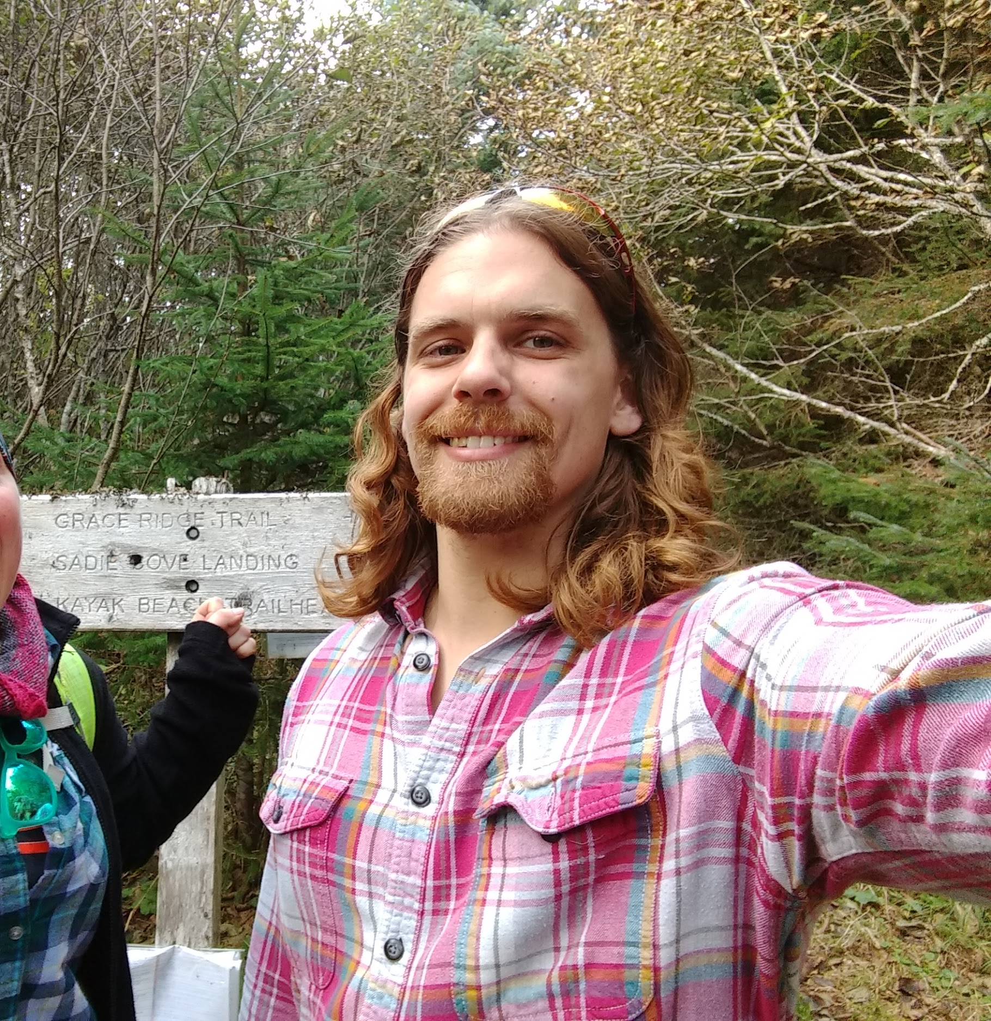
Joshy Orndorff
I like to:
Build on Substrate
Give Technical talks & workshops
Host Substrate Seminar
Write Substrate Recipes
Attempt a Philosophical talk
These slides: https://parity.link/shared-storytelling

Slide 3
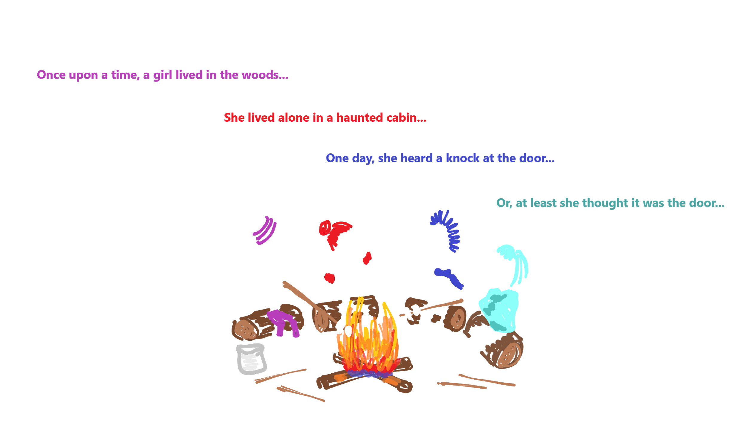
Blockchain’s Role in Society
Notes:
In this talk, I want to zoom out from the details of rust crates, frame pallets, finality proofs and import queues, and instead think about blockchain’s role in Society and its place in history. I’m going to do it by making analogies to a game I used to play as a kid, so I’ll start by explaining the game.

Slide 4
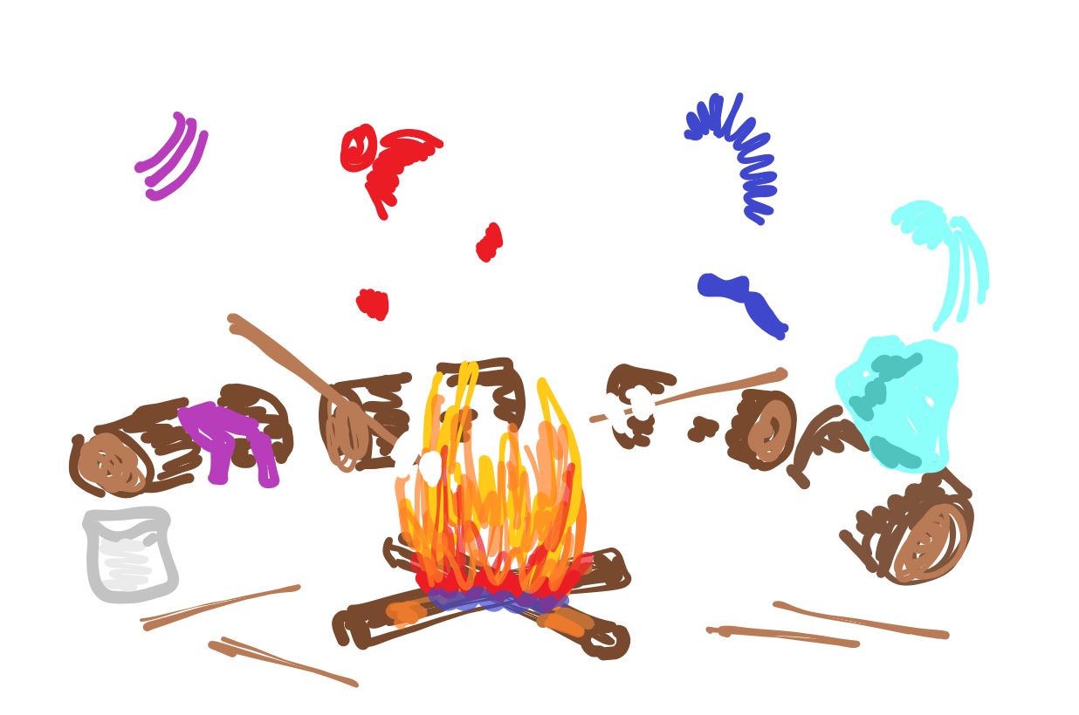
Thesis: Blockchain is Shared Storytelling
This idea is
Simple
but also
Profound
Notes:
In this talk I’ll advocate that blockchain is nothing more, and nothing less, than a tool to formalize this storytelling game.
Once it’s explained this idea is quite simple. But it is also profound.

Slide 5
Contents of this Talk
Part I History of Storytelling
Language
Oral Tradition
Writing
Cryptography
Part II Applications & Abstraction
Runtime What’s the story about?
Authorship Who adds to the story?
Finality Which story is true?
Part III Blockchain & the Monomyth
Familiar Examples Our favorite stories retold
In the Future What (might) come next
Notes:
Here’s an overview of what we’ll talk about.
First I’ll explain what storytell is, and why shared storytelling is important. I’ll try to convince you that developing better tools and techniques for shared storytelling is what humanity has been up to for hundreds of thousands of years, and that blockchain is a notable step in that direction.
Next we’ll look at three important aspects of shared storytelling, how they are manifest in Blockchain, and how they are modularized and abstracted in Substrate in particular.
Finally, I’ll retell some well-known stories through the lens we’ve just polished, and suggest some directions that storytelling research may head in the future.

Slide 6
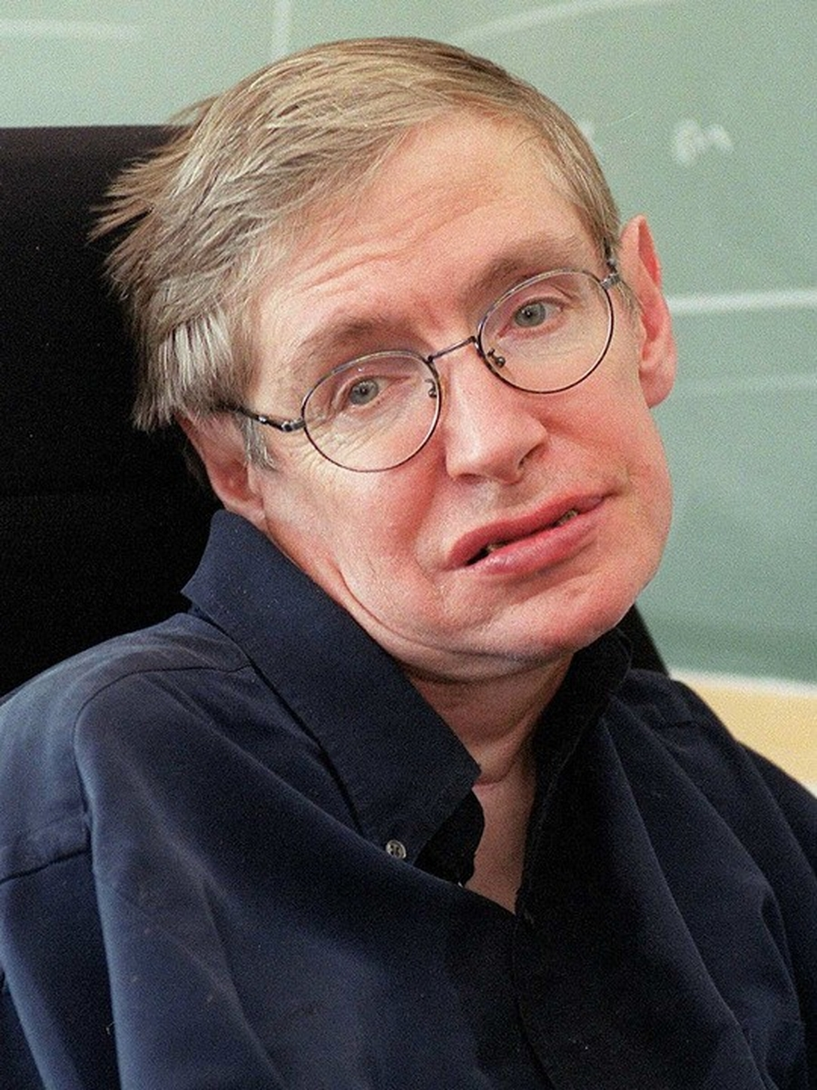
Part I - History
For millions of years mankind lived just like the animals. Then something happened that unleashed the power of our imagination. We learned to talk and we learned to listen. Our greatest hopes could become reality in the future. With the technology at our disposal, the possibilities are unbounded.
Full Quote Pink Floyd Song
Notes:
Joke about before 2009. But in this case we’re actually going back to real pre-history. Let’s start with the advent of Language

Slide 7
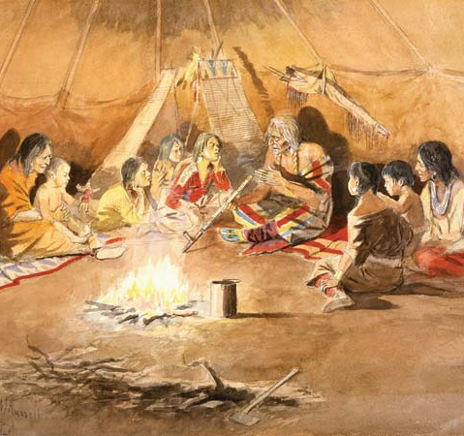
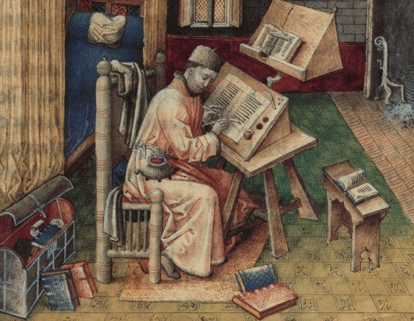

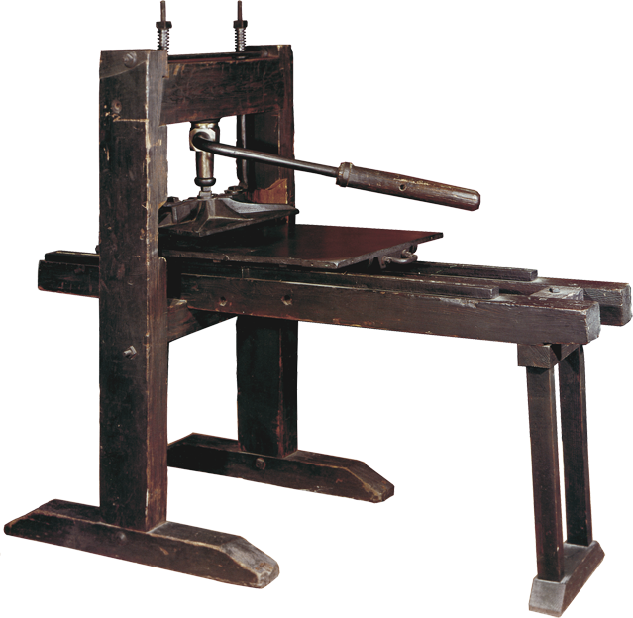

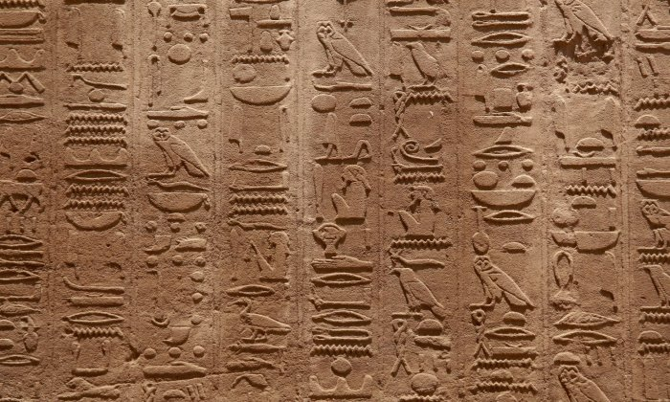
Part I - History
-100k years -10k years -1k years -100 years -10 years
Notes:
Joke about before 2009. But in this case we’re actually going back to real pre-history. Let’s start with the advent of Language
30,000BC? Oral Tradition
7000 BC Pictograms
2000 BC Writing
1400 AD Printing Press
1960 AD Hash Functions

Slide 8
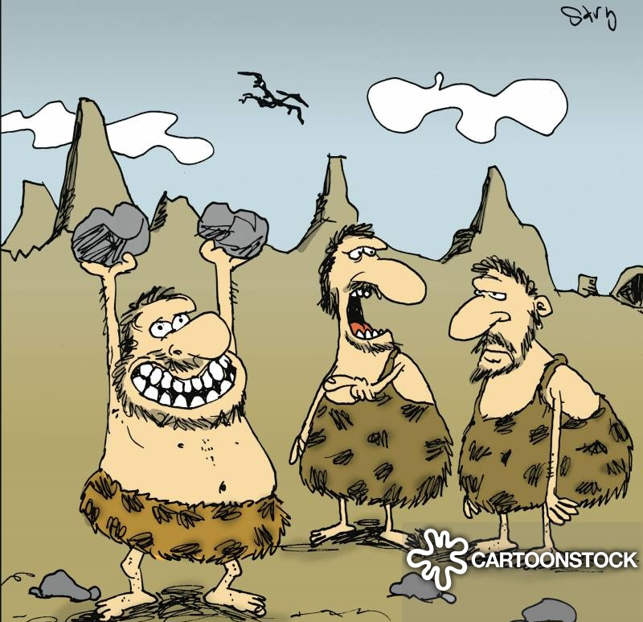
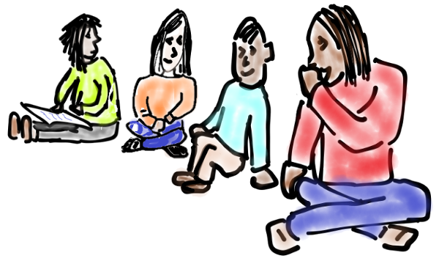
Language and Oral Tradition
Notes:
Language itself gives us the ability to communicate and coordinate with people in the spaces immediately around us. A single caveman can only build a house with stones so big. But with language that caveman can say, “Hey, you lift that end and I’ll lift this end.” Now they can build with bigger bricks.
“After we build my house, we’ll build yours” probably came much later. I can imagine two former-cavemen sharing a primitive version of the story. First we had no houses. Then we built a house. Then we built a second house. Now we’re not cavemen.
--------------
Oral Tradition, extends the ability of language to communicate across time, even periods of time spanning multiple generations. By repeating culturally relevant stories wisdom can flow on to future generations. Of course telling stories in this way does have some disadvantages.

Slide 9
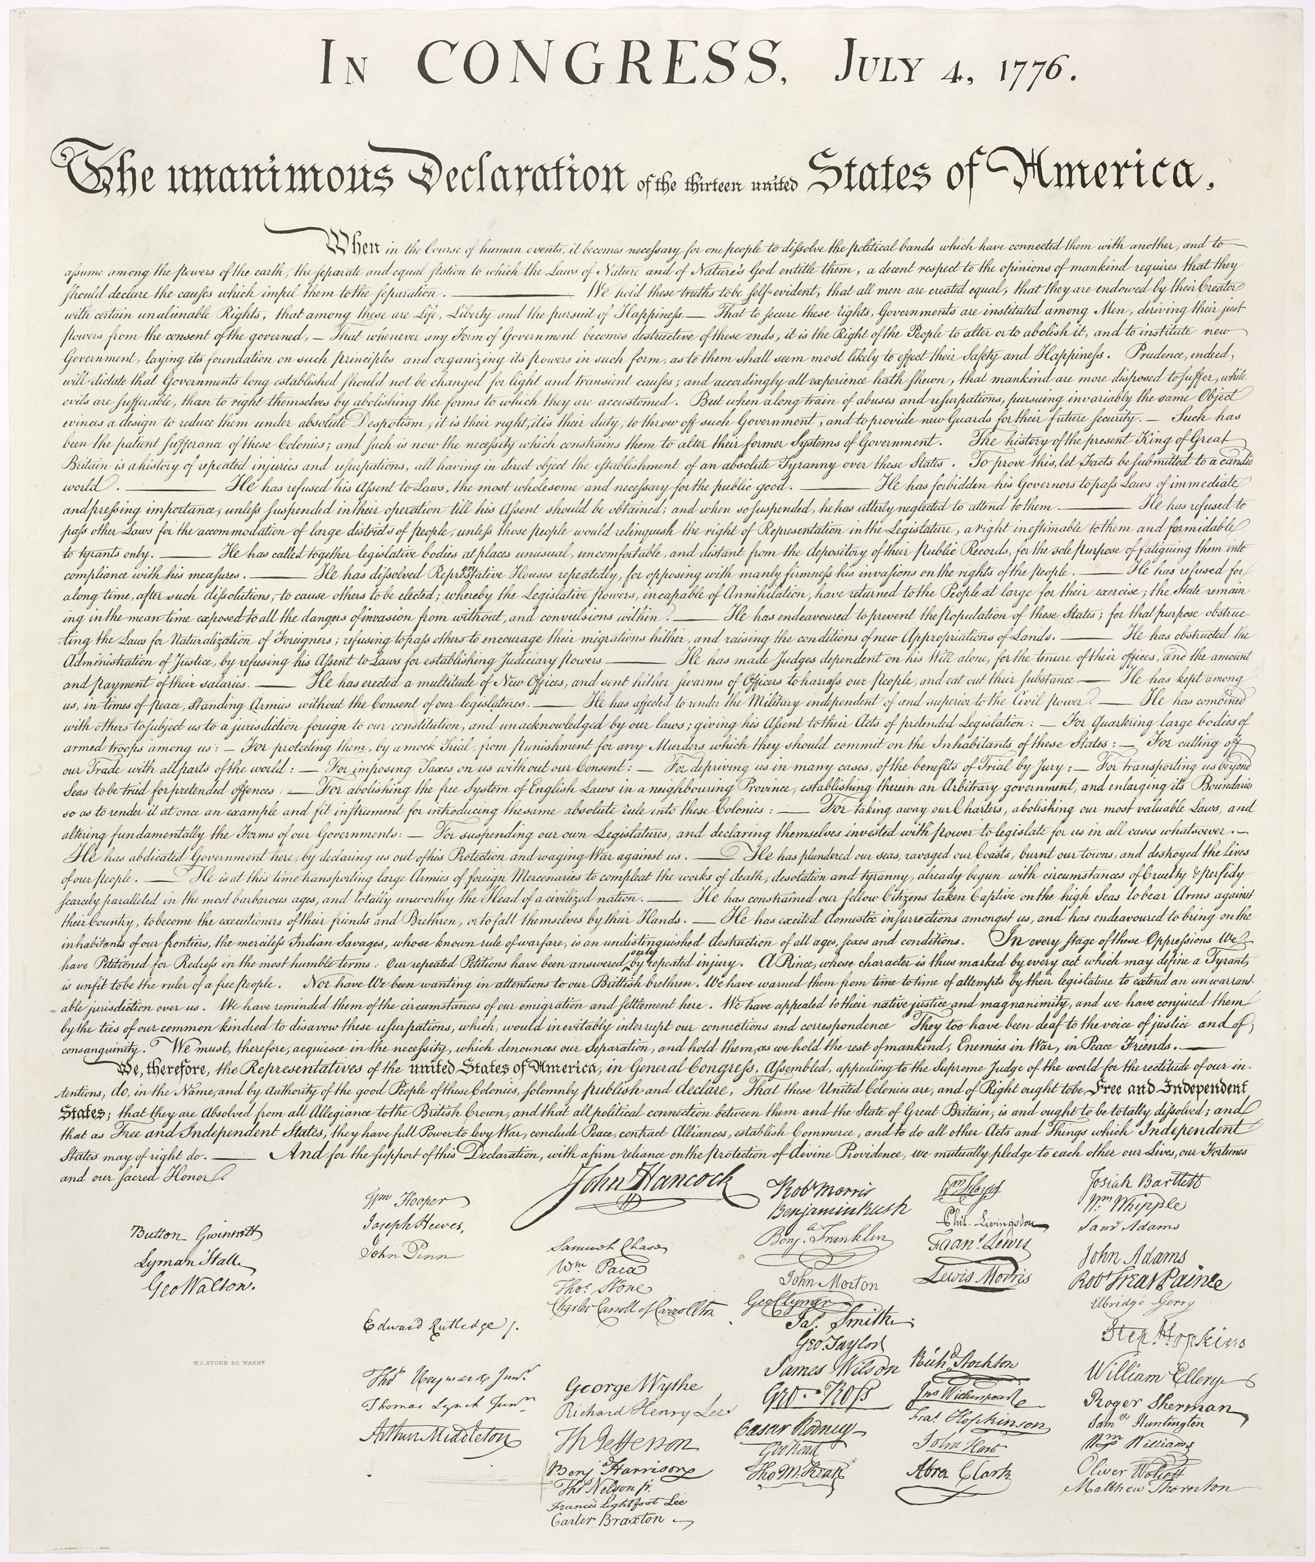
Modern Writing Systems
"For quartering large bodies of armed troops among us"
"For cutting off our Trade with all parts of the world"
"For imposing Taxes on us without our Consent"
Notes:
Allows people to communicate over much longer periods of time. And much more reliably. It’s no longer a telephone game with accidental or intentional mutation at each step.
Because of writing, (and the internet) I know that the american colonies declared independence for exactly these reasons (and others). I have a clearer understanding of where I, myself, came from. And a greater ability to
https://en.wikipedia.org/wiki/Grievances_of_the_United_States_Declaration_of_Independence

Slide 10
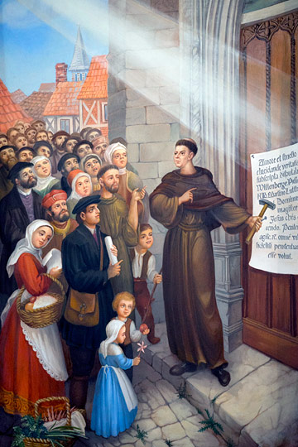
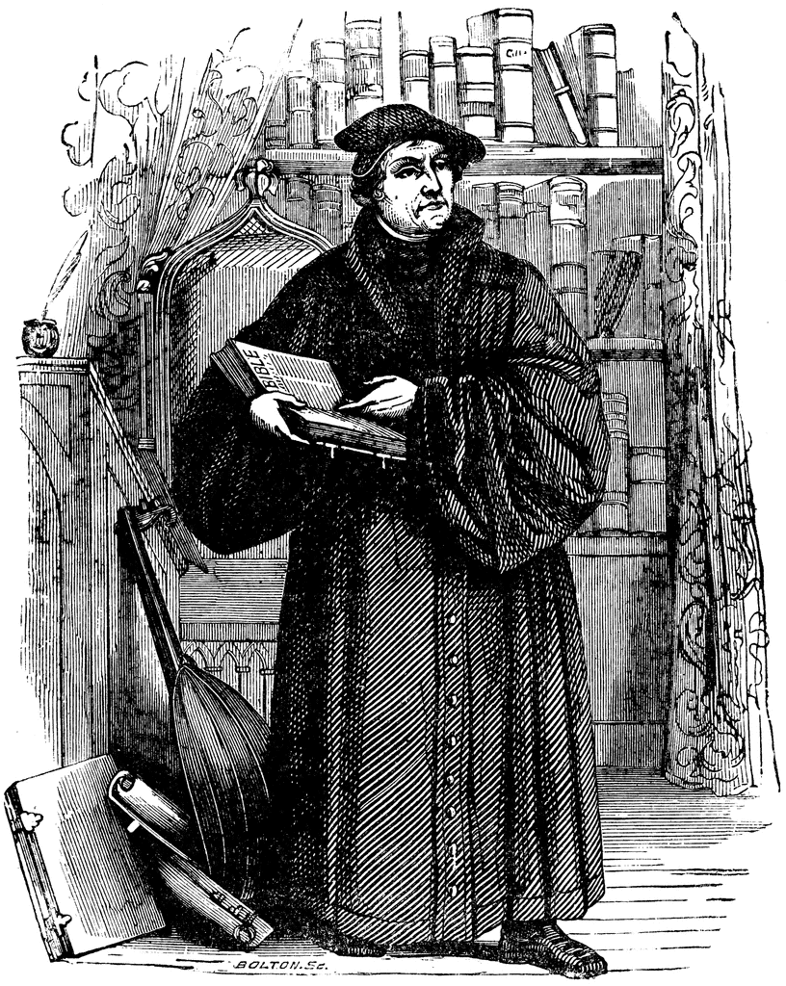
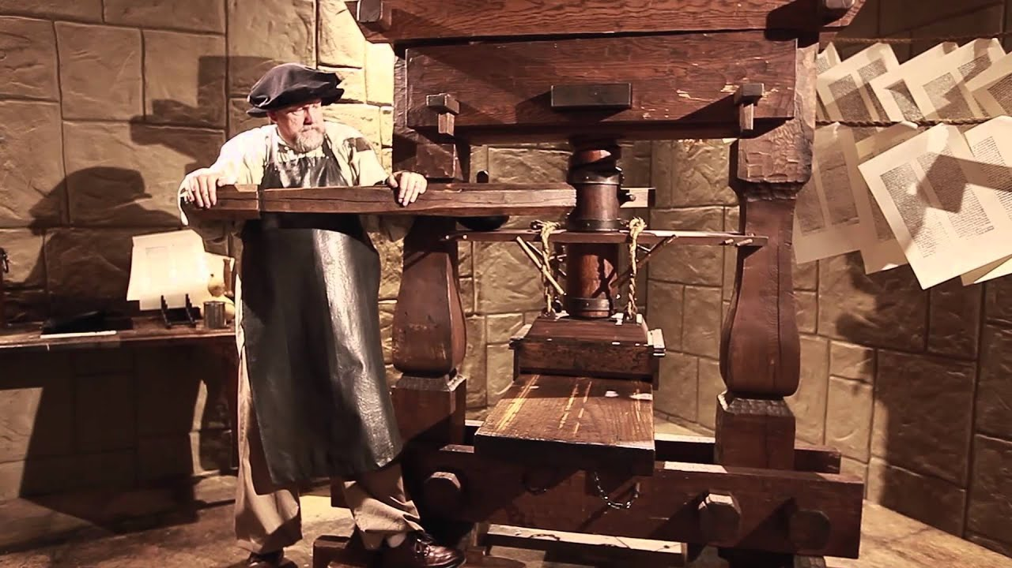
Distribution Systems
Notes:
Distribution systems such as the printing press extend the usefulness of writing systems by making written content widely available.
As an example, I’ll share a story about Martin Luther, the famous founder of the Protestant Revolution. In 1517, he wrote his famous 95 theses stating some concerns about the Catholic Church’s practices. Among his complaints were selling indulgences, and the disproportionate wealth of the Church and the Pope. He later complained about the Church’s intellectual gatekeeping by insisting the Bible only be published in Latin. You may recall the famous apocryphal story of Luther Dramatically nailing these theses to the door of the All Saints Church.
To address this gatekeeping, Luther translated the Bible to German and encouraged everyone to read it and interpret it for themselves, freeing them from the reigns of the Church’s interpretations. Luther’s translation is not the first German translation of the Bible, but it is by far the most successful, due largely to the fact that he was able to widely distribute it thanks to the printing press. By challenging the central authority of the Pope, and distributing the power to read the scriptures to the masses, Luther successfully hard forked the church.
The web is what allowed me to find the exact quotes from the declaration of independence. And really do nearly all of my research for part one of this presentation.

Slide 11
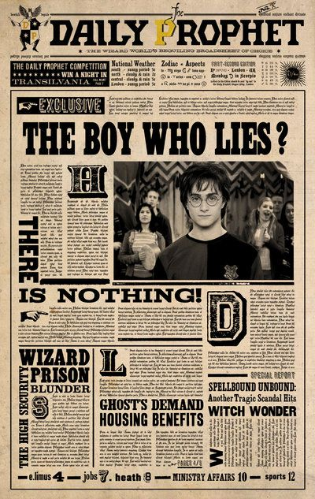


Malleable History
real-world examples
Better prepare to fight Dark Lord
Better be cautious around Harry and Dumbledore
Harry’s Story
Ministry’s Story
Previously, the Dark Lord was powerful.
Harry defeats Dark Lord at one year old.
Harry & Cedric taken to Dark Lord’s lair.
Dark Lord returns and kills Cedric.
Dumbledore speaks of Dark Lord’s return.
Previously, the Dark Lord was powerful.
Harry defeats Dark Lord at one year old.
Harry & Cedric alone together.
Harry emerges with Cedric’s body.
Dumbledore (mis)speaks of Dark Lord’s return
Notes:
Written history allowed humankind to make a ton of progress. But it still has weakness. Specifically, it is malleable, or subject to mutation. Let’s look at an example from Fiction.
--------------------
If you believe one of these stories, you will struggle to coordinate with people who don’t share your story.
We see this in real life. People who are primarily concerned about the climate and people who are primarily concerned about employment and economic productivity, sometimes fail to coordinate on environmental policies.

Slide 12
More Malleable History
Maybe delete this slide (?)
In an even nastier scenario, history can be mutated to trick parties with uncommon stories into coordinating against their will. Con man want to rob a vault to retrieve an artifact valuable only to him. Convinces several key players to participate in his heist under different pretenses.

Slide 13

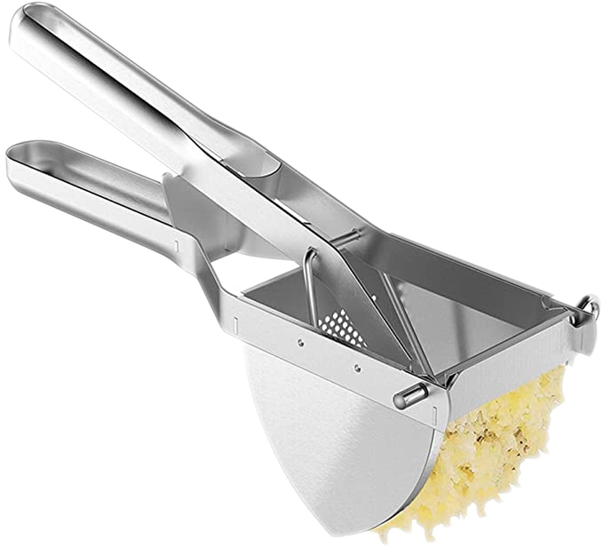

Basics of Hashing
Potatoes go in
“Potatoes”
“Potatoes!”
Pull lever
Hash comes out
“0x51F10F”
“0x40FCF1”

Slide 14

Hash-Linked History
Previously, the Dark Lord was powerful.
Harry defeated Dark Lord at one year old.
Harry & Cedric taken to Dark Lord’s lair.
0x000000
0x456D86
0x86F158
0x456D86
0x86F158
0x467F05
Notes:
I’m not just talking about hashing because I love potatoes, although I do love potatoes. Hash functions can solve the problem of malleable history. This technique was first applied in version control systems like git and monotone.
When you start telling a new story, you write down the first part, and this 0-filled hash-looking thing. You’ll see why that’s important shortly.
And just for heck of it, let’s hash that.
Now to add the next part...

Slide 15
Forks & Branches
Harry & Cedric taken to Dark Lord’s lair.
Dark Lord returns and kills Cedric.
Dumbledore speaks of Dark Lord’s return.
0x86F158
0x467F05
0x2ca978
Previously, the Dark Lord was powerful.
Harry defeated Dark Lord at one year old.
0x000000
0x456D86
0x467F05
0x2ca978
0xd254e7
Harry & Cedric alone together.
Harry emerges with Cedric’s body.
Dumbledore (mis)speaks of Dark Lord’s return.
0x456D86
0x86F158
0x86F158
0xc75d6b
0x2e5734
0xc75d6b
0x2e5734
0x9e7a99
Notes:
Simply linking the story by hash doesn’t mean there will only be one story. Disagreements, known as forks in blockchain, and branches in git, can and do still happen.
But two things are gained.
Your story cannot change without you realizing it.
And you _know_ when you have a different story than your peer.

Slide 16
Bitcoin
Tells a shared story about money
The story is hash-linked to avoid malleability
The story is distributed on the web
Forks resolved by a fork selection rule
Notes:
In 2009 the bitcoin network went live. It built on top of the tools we’ve just discussed, and added a consensus layer to resolve forks.
By making it difficult to create new blocks and dictating that the longest known chain is considered the real one, bitcoin introduced to the world the very first shared story with global consensus

Slide 17
Part II - Applications and Abstractions
5
Written in Rust
Built into Wasm (& native)
What is the story about?
Runtime
Who gets to tell the story?
Authorship
Finality
Which story is true?
Written in Rust
Built into native
Tx Pool
Block Storage
Peer Management
libp2p
jsonRPC
Notes:
The historical inventions we discussed in part one have gotten us _very_ far, and the contributions of Bitcoin seem quite promising. But Bitcoin tells a very specific story about money enforcing very specific rules about who can author and how to decide which chain is real.
As a general tool for shared storytelling, blockchain can be used to tell a rich variety of stories about different topics with different rules about who can author and how you know which story is real. Substrate provides meaningful abstractions for each of these pluggable components and allows blockchain to be easily applied to many different stories. In part II we’ll explore these abstractions.
------------
This diagram is taken directly from a technical talk about building blockchains with Substrate. It shows the various parts of the node. Today we’ll explore three particular parts, and how they are related to shared storytelling. We’ll look at the runtime, the authoring , and the consensus.

Slide 18
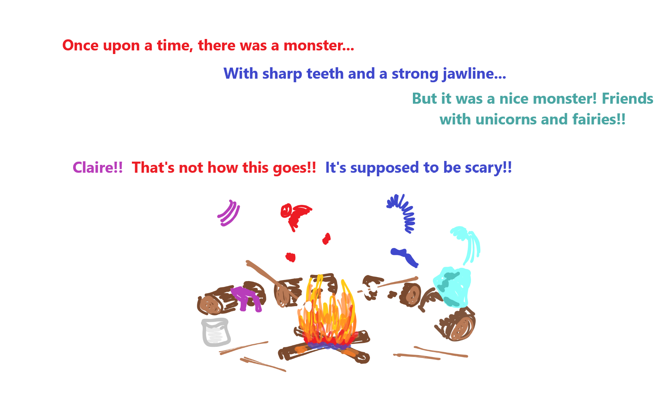
The Runtime - What is the story about?

Slide 19
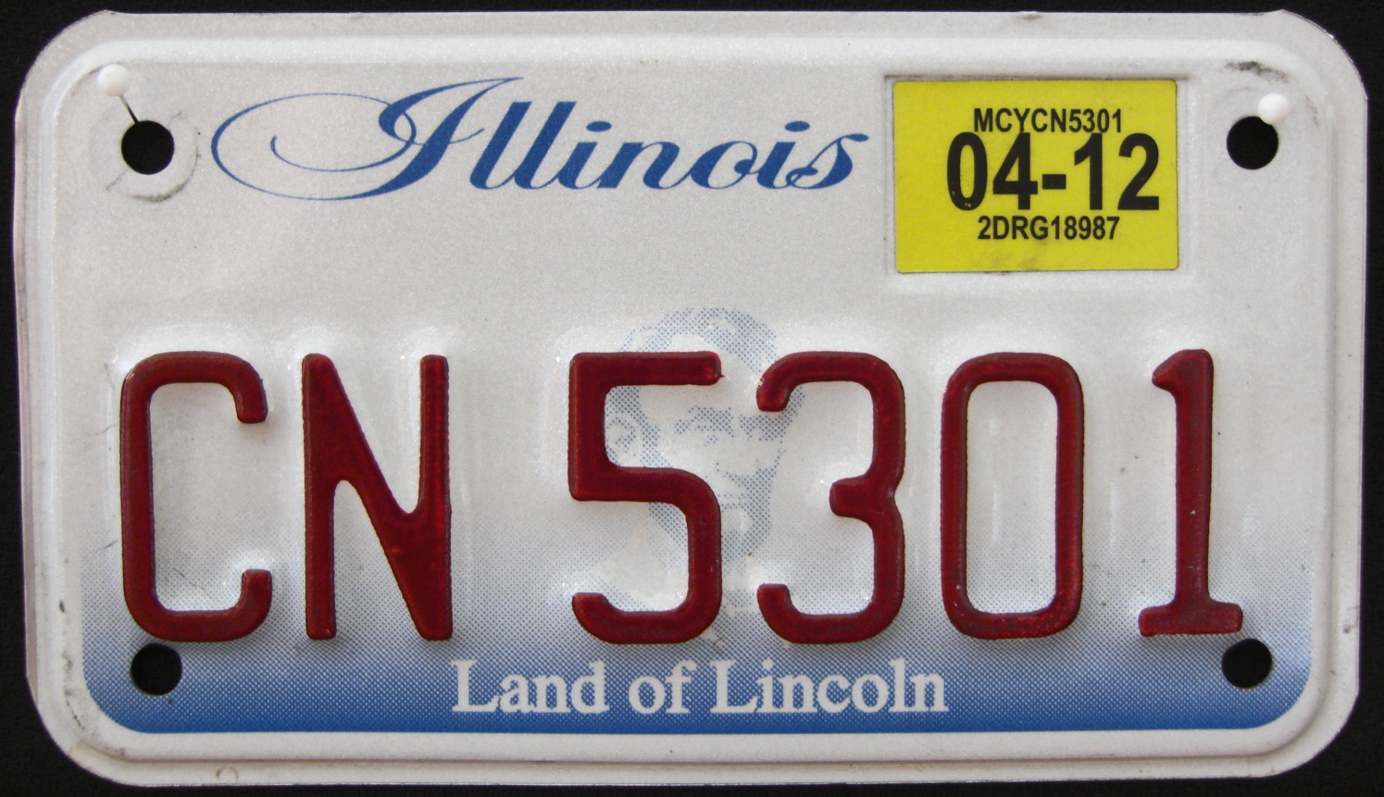
Some Practical Runtimes
Alice registers truck
Bob registers car
Bob crashes car, registration suspended
Alice’s registration expires
Charlie registers car
Bob passes safety inspection
Vehicle Registration
Notes:
TODO draw example chains for each one

Slide 20
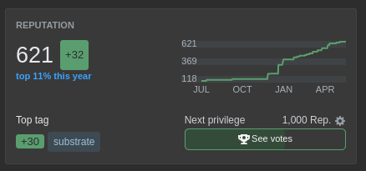
Some Practical Runtimes
Alice satisfies a customer
Bob satisfies a customer
Bob receives a complaint
Clair receives a complaint
Bob’s complaint resolved
Reputation System
Notes:
Reputation systems are critically valuable for trust hueristics. You encounter them everywhere from seller ratings on ebay or etsy, to Stack Overflow reputation, to your plain old credit score.

Slide 21

Some Practical Runtimes
Alice satisfies a customer
Bob satisfies a customer
Bob receives a complaint
Clair receives a complaint
Bob’s complaint resolved
Money
Notes:
And of course, bitcoin’s own runtime is all about money. Money is a hugely useful coordination mechanism. It’s what allows me to contribute to society by writing software for Parity, and use the redeem the fruit of my labor for groceries at a local food mart who may have never heard of Parity.
There are lots and lots of other useful runtimes. Perhaps even the state of an entire virtual computer like in ethereum and other smart contract platforms.

Slide 22
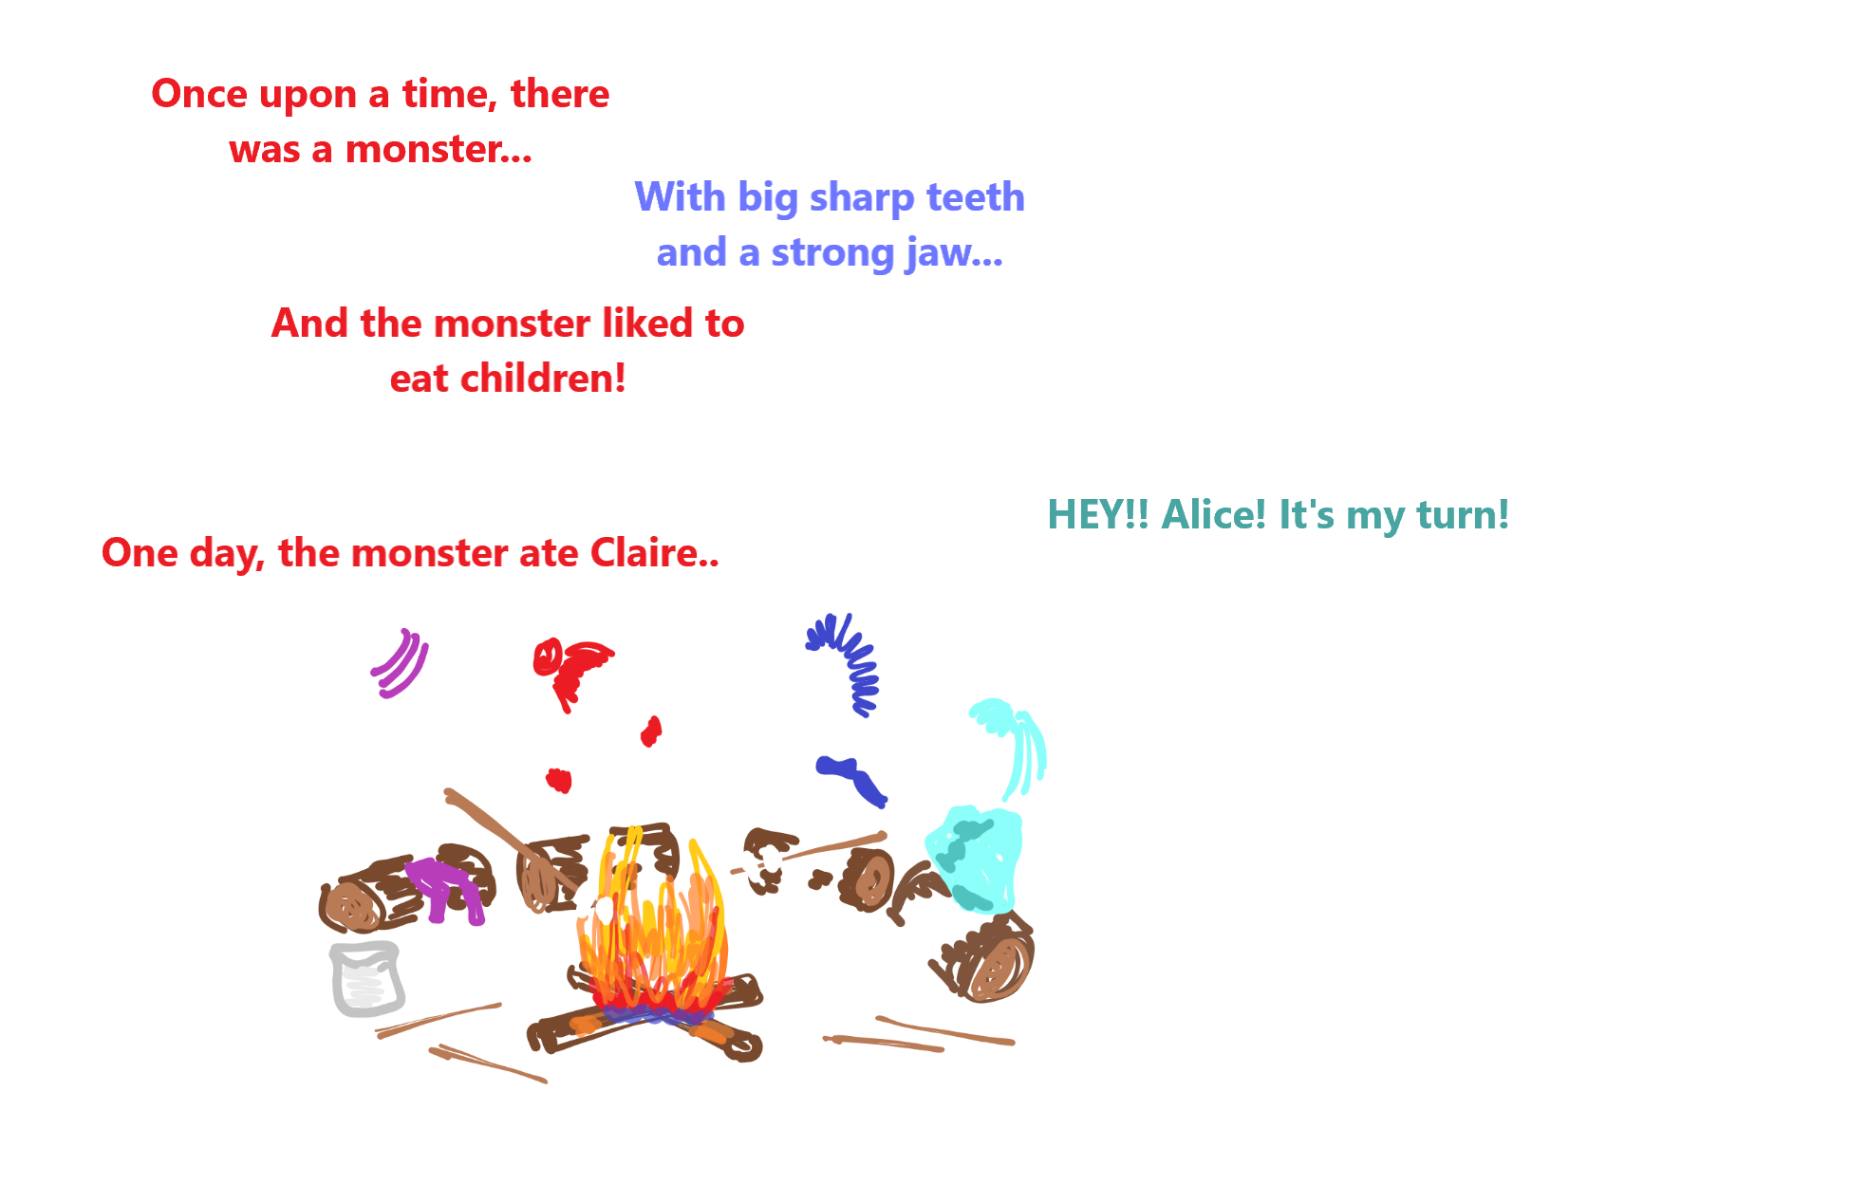
Authoring - Who gets to tell the story?
Notes:
The next abstraction we’ll look at is authorship. It allows us to specify who gets to author the next block, or part of the story, and when. As we see in the cartoon

Slide 23
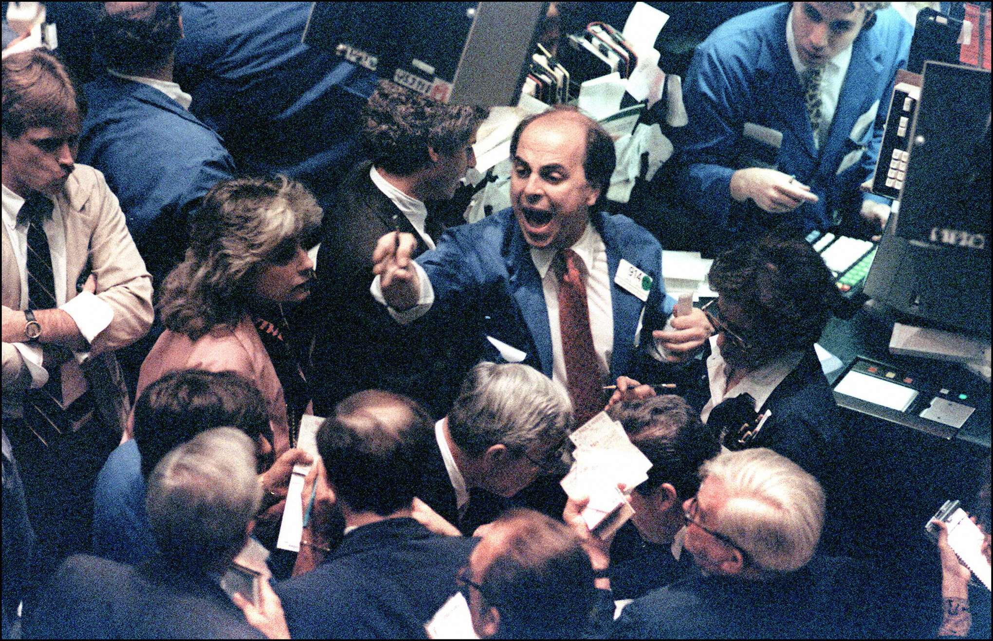
Some Practical Authorship Schemes
impractical
Free For All
Notes:
The first scheme that comes to mind, especially when thinking of permissionless networks is to allow anyone to author at any time. While this may work in some small and mutually trusting groups, it is not practical in most settings. Too many authors will be authoring at once, and no one will be able to keep track of all the stories going on. The story will fork endlessly.
-------------------
In practice we have to throttle the authoring somehow.

Slide 24
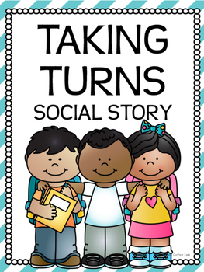

Some Practical Authorship Schemes
Proof of Authority & Proof of Stake
Notes:
Proof of authority is a class of authoring schemes where there is a pre-agreed set of authorities who are allowed to author. No others are allowed to author ever (they may still participate by sharing their contributions with authorities who author on their behalf). Selecting which exact author goes next may be accomplished by simply taking turns in order (Substrate calls this Aura) or by a random or pseudo random technique analogous to throwing dice (Substrate calls this Babe, and is working on a second similar scheme called Sassafrass).
Any Proof of Authority mechanism may be converted to a Proof of Stake mechanism by coordination with the runtime.

Slide 25

Some Practical Authorship Schemes
Previously, the Dark Lord was powerful.
Harry defeated Dark Lord at one year old.
Harry & Cedric taken to Dark Lord’s lair.
0x000000
0x456D86
0x86F158
710 kWh
695 kWh
709 kWh
Proof of Work
Notes:
Another option is Bitcoin’s own proof of work. In this scheme anyone may participate eliminating the need for a set of authorities. The throttling is accomplished by insisting that one must consume some energy solving a mathematically difficult problem.

Slide 26
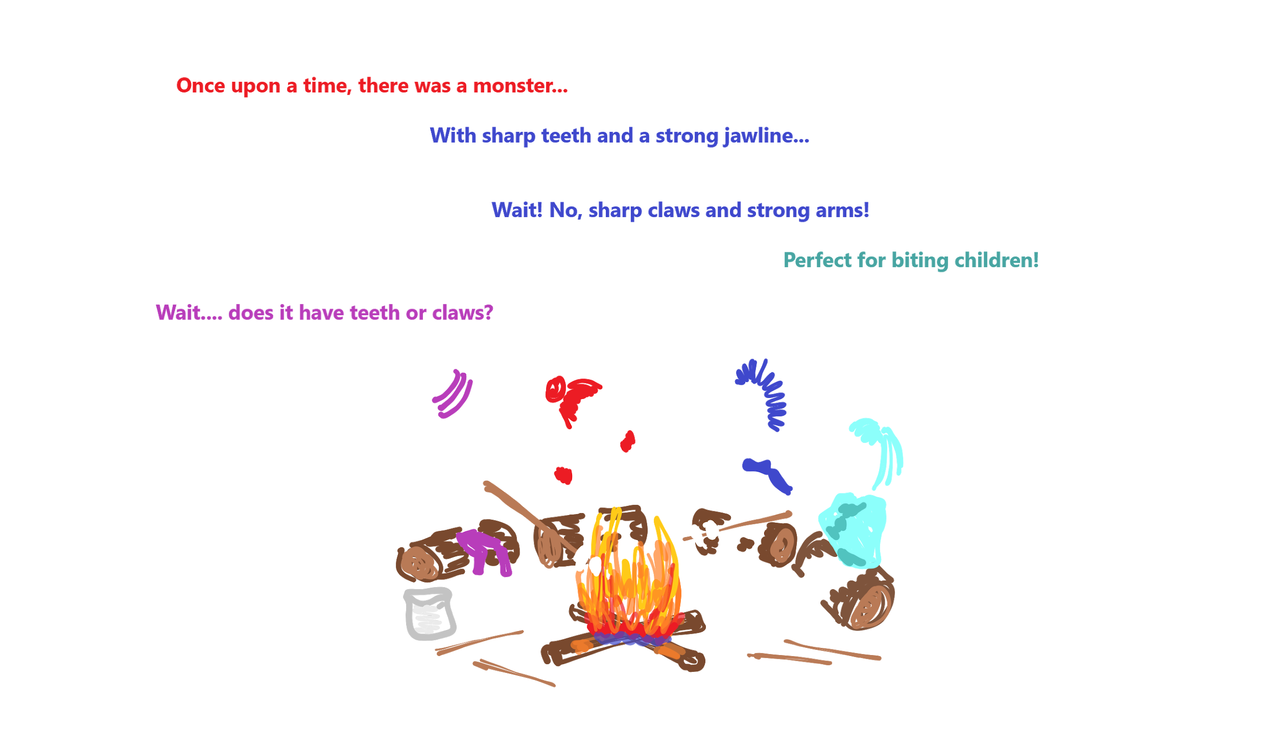
Finality - Which story is real?

Slide 27
Fork Selection
Where to add to the story?
Notes:
Most authorship schemes will eventually lead to forks. There is nothing about fundamentally wrong with forks. But, as we saw with the Harry Potter example, when they aren’t resolved we can no longer coordinate.
Is that vehicle legally registered? Do I feel safe with it on the roads?
Should I buy from this seller? Will they rip me off?
Does Eve really have the money she is trying to pay me with?
Should I gear up to fight the Dark Lord? Or just keep my distance from Harry?
We need some way of choosing which chain is the “real” one. Bitcoin introduced a common fork choice rule known as the longest chain rule. If all authors use the longest chain rule toselect where to author their blocks, then that chain continues growing longer and we have agreement on the story.

Slide 28

Reorganization
Notes:
The problem with relying solely on a fork-choice rule like the longest chain rule is that you get reorganizations. In the case of the longest chain rule, when another chain becomes longer, your story and thus your understanding of the world changes.
An example that I experience pretty often is being unable to find a key. I check all the common places and the key is not there. Later my wife finds the key in one of the places I already checked. I’m forced to reorganize from a story where I checked for the key and it wasn’t there, to a story where I checked poorly, failed to find it, and later realized it had been there all along. Embarrassing.
Reorganizations can be more than embarrassing though, they can alter one’s worldview. ----show santa---- Remember when you realized that Santa isn’t real? When a child finds out that Santa is not real she has typically believed in Santa her entire life, been told by her friends and loved ones that Santa is real, and personally witnessed the presents showing up on Christmas morning. Accepting the deception can be challenging and enlightening.

Slide 29

Finality - Which story is real?
Notes:
We’ve discussed fork selection. We’ve seen that reorgs are hard. There is a natural desire to say that something is “final” and will never be reorged away. For this we use a finality gadget. Finality is a way to decide, typically by casting votes, that we will never reorganize away from a particular block. It is a ratcheting mechanism in that it moves forward but never backward.
As with runtime and authorship, there are multiple real-world finality gadgets including “GRANDPA”, “Casper”, and others. The details of how they work is out of scope

Slide 30
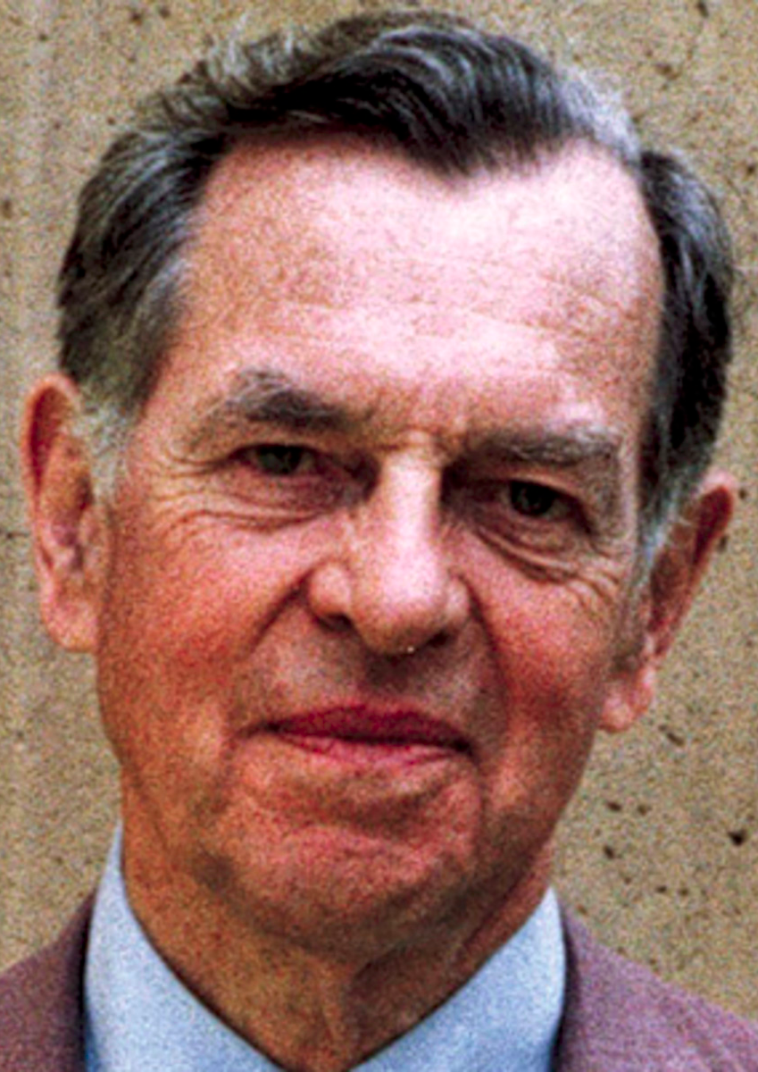
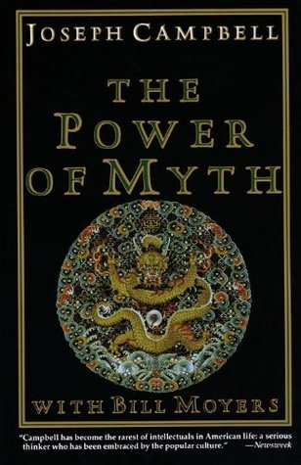
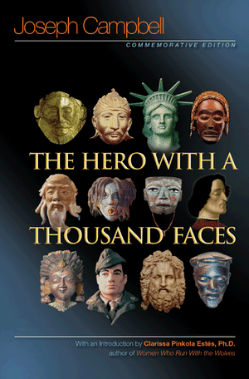
Part III: Blockchain and the Monomyth
Notes:
Joseph Campbell describes the monomyth as …. We all tell and live the same stories over and over.
To drive home some of the points we’ve presented in this talk, let’s re-tell some familiar monomyth-style stories in blockchain terms.

Slide 31
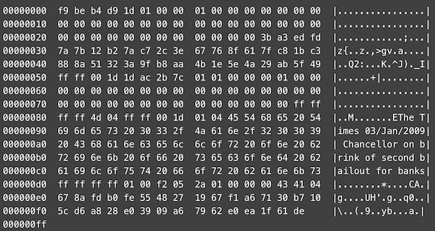
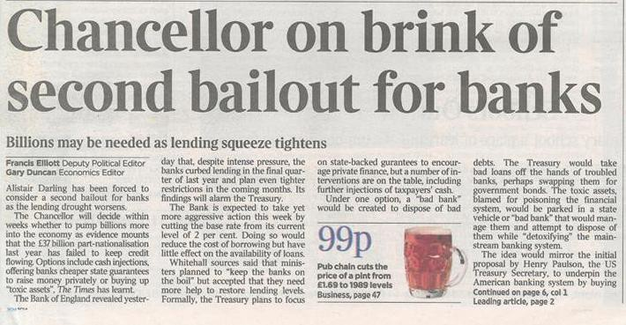
Creation
Notes:
Nearly every culture has a creation story. You’re likely familiar with one or two. The creation story is sometimes understood literally, and sometimes not. Traditional creation stories typically provide humanity not only with a physical world to explore, but with an orientation and worldview. The beginning of a shared story and a common understanding.
Blockchain-based stories also begin in this way. In fact the first block in a chain is called the “Genesis block” after the Judeao Christian creation story. Bitcoin’s genesis block not only explicates the initial state of the world, a single bitcoin transaction rewarded to the block’s miner. It also instills such a worldview. Can you see the worldview in the genesis block?
Substrate offers a reusable GenesisConfig struct that facilitates starting stories wherever necessary.

Slide 32
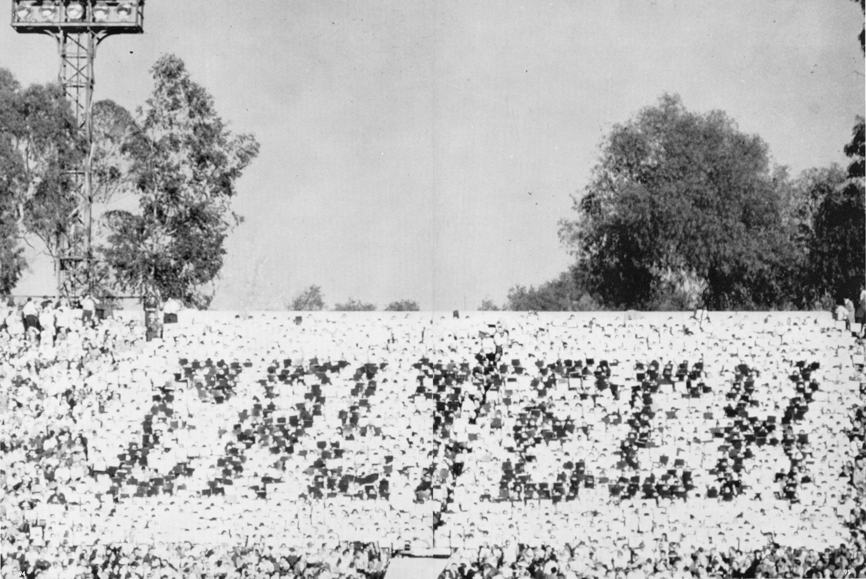
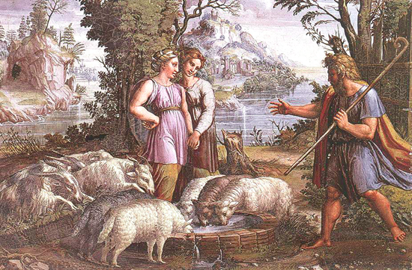
Deception
Notes:
Stories of deception and subsequent realization that the real world is not as one had thought are common. You can likely think of your own.
These stories can be interpreted as reorganizations
Great_Rose_Bowl_Hoax of 1961
Jacob tricked into marrying Leah instead of Rachel

Slide 33
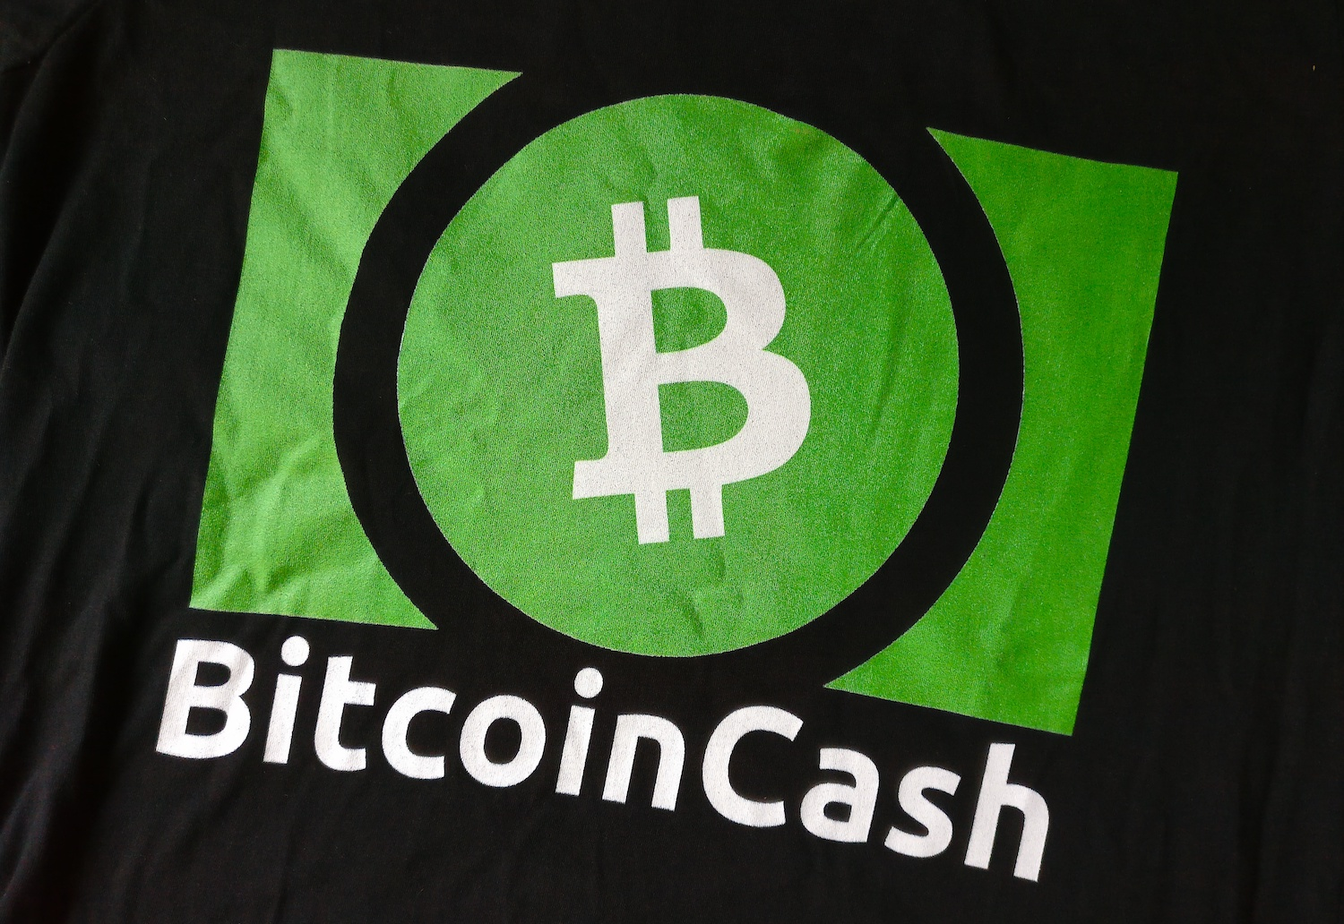
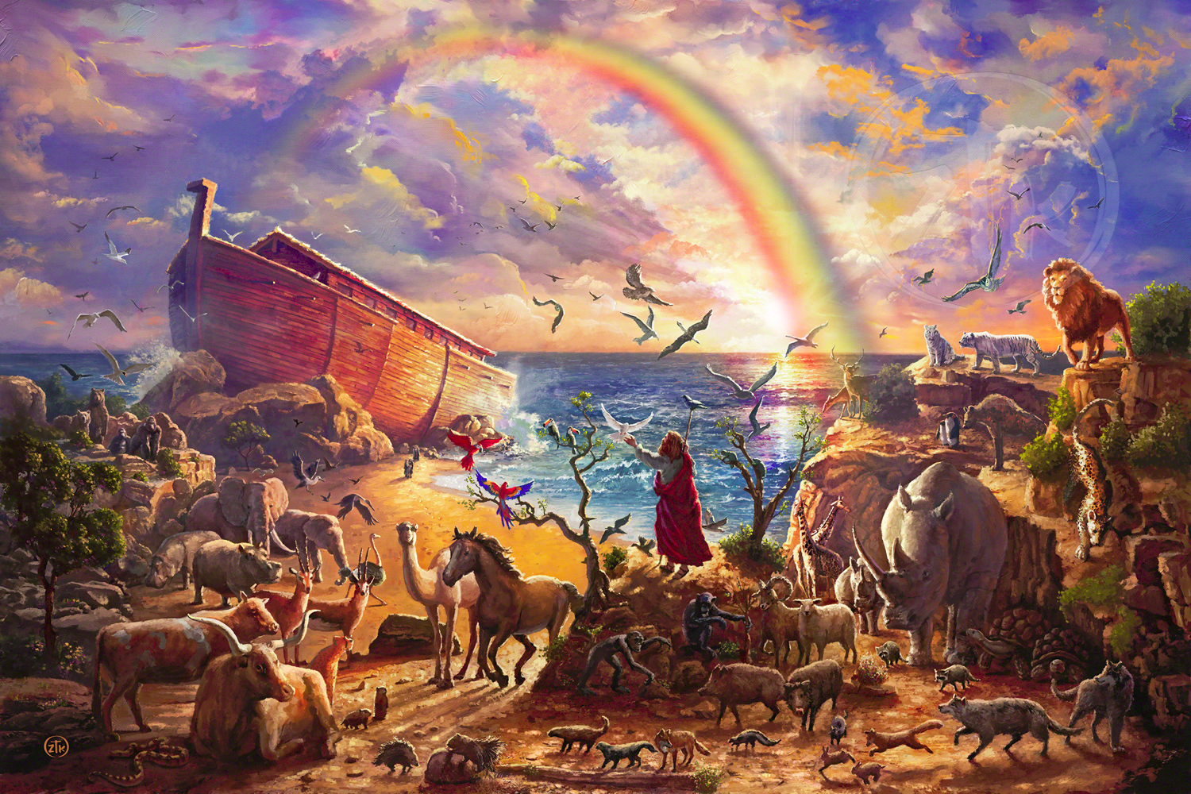
Great Flood
Notes:
Many cultures have a flood narrative as well. One popular version from the Epic of Gilgamesh goes like this:
The "great gods" Anu, Enlil, Ninurta, Ennugi, and Ea were sworn to secrecy about their plan to cause the flood.
But the god Ea (Sumerian god Enki) repeated the plan to Utnapishtim through a reed wall in a reed house.
Ea commanded Utnapishtim to demolish his house and build a boat
A portion of the bitcoin community lived this narrative in the summer of 2017 ----------------------
When some of the community wanted to “destroy” the bitcoin network by including a feature called “segregated witness”, a minority of developers and community members, quit working on bitcon and build a boat called bitcoin cash. On august first the boat took to the sea to whether the storm, and forty metaphorical days later landed safely with all aboard.
Unlike the gilgamesh flood, but like the Noah flood, the bitcoin cash community brought all of the token balances aboard to boat so that they would also survive the flood.

Slide 34
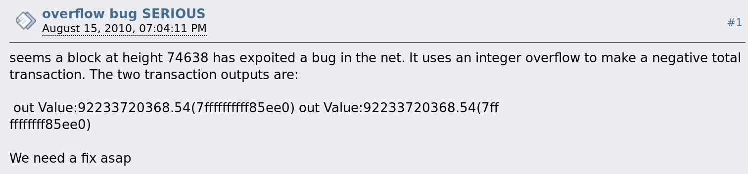
Overflow Bug
Notes:
This story can be interpreted in either of two ways depending on which side of the fork you think is real. On the side with the overflow transaction, it fis the miracle narrative. Like Jesus feeding the 5000
On the non-overflow side, it fits the flood narrative.

Slide 35
Stories Blockchain Hasn’t Told
Yet...
Notes:
We’ve seen that blockchain has proved an excellent tool for telling many of humanity’s favorite stories. We’re telling the same story that Luther did in liberating the scriptures, the colonists did in declaring their independence, and Satoshi did in decentralizing money. Here we explore some stories that blockchain hasn’t fully told yet.

Slide 36
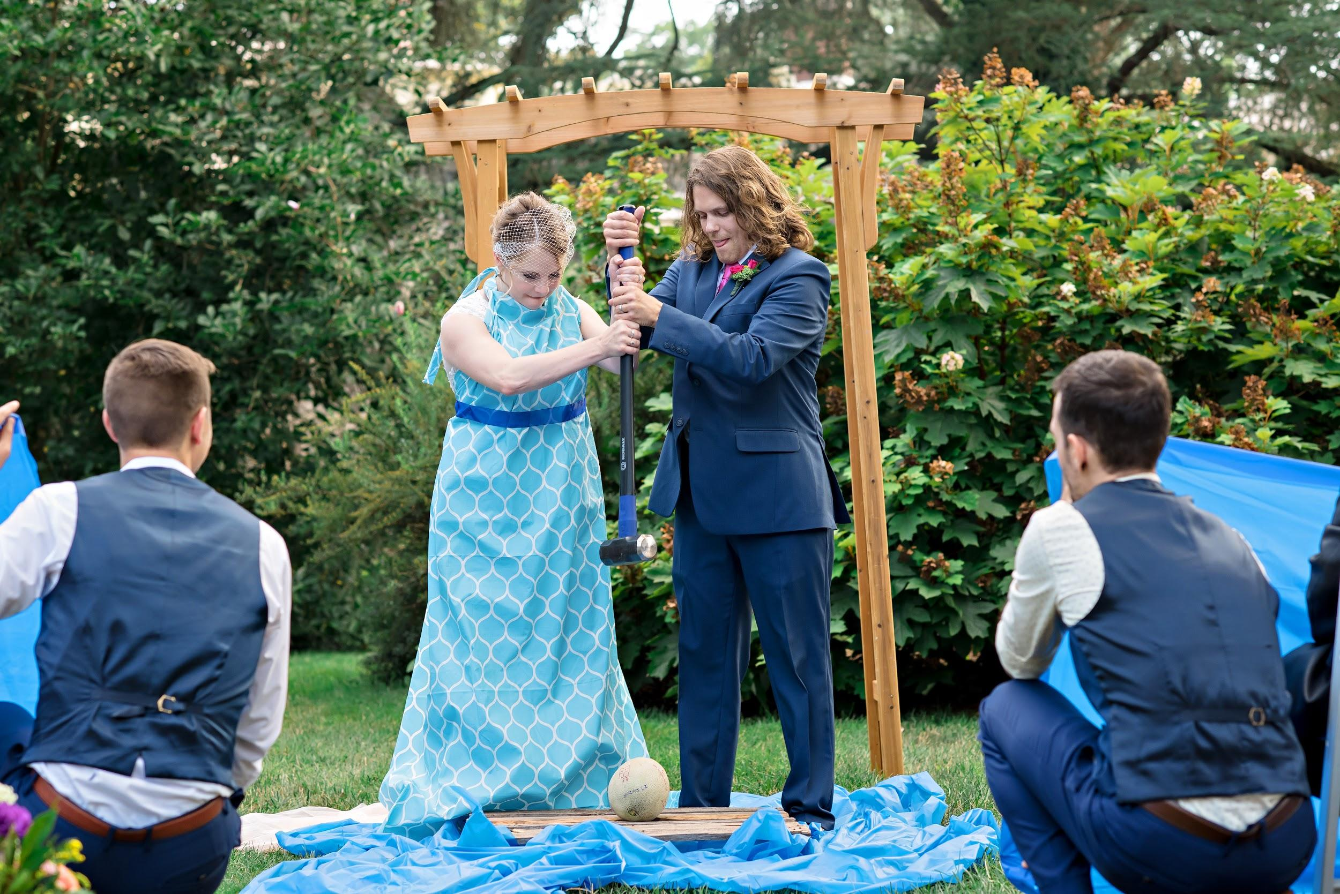
Marriages and Unions
Notes:
Many stories start out with individual characters living their individual lives. Later they come to meet and develop a common story together. A classic example is a marriage.
Hash-linked history supports this, and git calls it “merging”. It is challenging in Blockchains, because it requires synchronizing the individual stories which may be quite long and checking them for any incompatabilities. This process in computationally expensive especially as more and longer chains attempt to merge.

Slide 37
Directed Acyclic Graphs
Notes:
Once chains are able to merge, there is no reason they can’t fork apart and then merge back together later. The mathematical term for blockchains that fork and merge like this is a “Directed Acyclic Graph” or a “DAG”. Forking and merging like this allows different parts of the story to evolve concurrently. This is my highest hope in shared storytelling. Telling our story over a DAG like this still has several practical technical problems to be overcome.

Slide 38

Stories about Stories
Notes:
There is another design that works today. It is even built on Substrate. Here the pink circle is a blockchain that tells stories about other blockchains represented as pink squares. When one of the square blockchains adds a block to its story, the circle blockchain adds a block to its own story indicating that it has heard the square chain’s story. Does anyone recognize this design?
--------reveal Polkadot word
This is the architecture of the Polkadot network. In this design, independant blockchains, known as parachains, tell their own stories. The parachains draw their finality from the relay chain in the center. Because they all share the same view of what is final, they can draw upon each others stories. This allows telling overarching stories that compose elements from individual parachain stories.
Example:
One parachain is a vehicle registry, and one is a currency. Now we can tell stories about charging fees for registering a vehicle.

Slide 39
Blockchain and
Shared Storytelling
For the last hundred thousand years, humans have developed tools for shared storytelling. Substrate is our greatest achievement yet.
JOSHY ORNDORFF Software developer Parity Technologies joshy@parity.io | @joshyorndorff github.com/JoshOrndorff
My Other Work substrate.dev/recipes substrate.io/seminar

